Slide 1
Working with Spring boot and Spring Framework
Aleksandar Markovic, Dejana Bezanovic, Bojan Pavlovic
Novi Sad, 20-05-2023

Slide 2
Agenda Slides
01
Spring Framework
02
Spring Boot

Slide 3

Spring Framework
01

Slide 4

About Spring Framework
Spring is one of the most widely used Java Frameworks for building Web applications.
Spring makes it easy to create Java enterprise applications. It provides everything you need to embrace the Java language in an enterprise environment.
Unlike other frameworks, Spring focuses on several areas of an application and provides a wide range of features.
Spring is open source. It has a large and active community.
Notes:
Spring je jedan od najcesce koriscenih Java frejmvorka za razvoj Veb aplikacija
Prvobitno objavljen u Oktobru 2002. godine, sto znaci da ove godine puni cak 20 godina.
Sastoji se od oko 20 modula koji olaksavaju pravljenje kompleksnih aplikacija.
Nije obavezno koristiti sve module, oni se pojedinacno mogu ubaciti u postojecu java aplikaciju po potrebi.
Spring se ni ne mora koristiti u kontekstu veb aplikacije.
Spring izvorni kod je otvorenog tipa, mozete baciti pogled na Github-u.

Slide 5
Inversion of Control
Inversion of Control is a principle in software engineering by which the control of objects or portions of a program is transferred to a container or framework. It's most often used in the context of object-oriented programming.
IoC enables a framework to take control of the flow of a program and make calls to our custom code.
The advantages of this architecture are:
- decoupling the execution of a task from its implementation
- making it easier to switch between different implementations
- greater modularity of a program
- greater ease in testing a program by isolating a component or mocking its dependencies and allowing components to communicate through contracts
Notes:
Centralni deo Spring frejmvorka je njegov kontejner za Inverziju Kontrole.
Inverzija Kontrole je princip po kojem se kontrola objekata i funkcionalnosti prepusta frejmvorku.
Omogucava Springu da vodi racuna o instancama objekata kao I da poziva nas custom kod.

Slide 6
Inversion of control
Object managed by Spring IoC is called a Bean.
@Configuration public class AppConfig { @Bean public Calculator calculator() { return Calculator. .builder() .brand("casio") .color("black") .build();ld() } }
@Component public class Calculator { public int sum(int x, int y) { return x + y; } }
Notes:
Springov kontejner za Inverziju kontrole je zaduzen za zivotni ciklus odredjenih objekata.
On kreira instance po potrebi, inicijalizuje ih I vezuje jedne za druge.
Objekti kojima upravlja ovaj kontejner se nazivaju Bean-ovi.
Vidimo primer konfiguracije jednog Bean-a.
Bean-ovi se mogu definisati u konfiguracionim klasama kao povratna vrednost metode.
Unutar te metode se kreira I konfigurise instanca.
Nakon ovoga, instanca je dostupna za uvezivanje u druge Bean-ove kako bi je koristili.
Drugi primer pokazuje kako mozemo napraviti nas custom Bean.
Kada bi pravili nasu biblioteku I zelimo da je integrisemo sa Springom, mogli bi koristiti anotaciju @Component nad klasom.
Tada je instanca te klase dostupna celoj aplikaciji kao Bean.

Slide 7
Dependency Injection
Dependency injection is a pattern through which to implement IoC, where the control being inverted is the setting of object's dependencies. An instance of dependency is created by Spring - control for creating instance is taken from the class that needs the dependency to the Spring framework.
The act of connecting objects with other objects, or “injecting” objects into other objects, is done by an assembler rather than by the objects themselves.
Notes:
U Springu je IoC kontejner implementiran pomocu paterna zvanog Dependency Injection, odnosno Injekcija Zavisnosti.
Kada se instancira neki Bean u Spring-u, provera se da li taj bean zavisi od drugih Bean-ova.
Ako zavisi, traze se odgovarajuce instance, I prosledjuju se Bean-u.

Slide 8
DepenDency Injection
Traditional Programming: Dependency Injection:
public class CashRegister { private Calculator calculator; public CashRegister() { this.calculator = new Calculator(); } public int sumArticlePrices(Article a1, Article a2) { return this.calculator.sum(a1.price, a2.price); } }
@Component public class CashRegister { @Autowire private Calculator calculator; public int sumArticlePrices(Article a1, Article a2) { return this.calculator.sum(a1.price, a2.price); } }

Slide 9
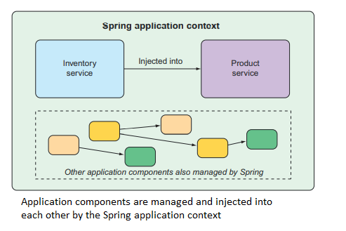
Dependency INJECTION
The act of wiring beans together is based on a pattern known as dependency injection (DI). Rather than have components create and maintain the lifecycle of other beans that they depend on, a dependency-injected application relies on a separate entity (the container) to create and maintain all components and inject those into the beans that need them.
Notes:
Historically, the way you would guide Spring’s application context to wire beans together was with one or more XML files that described the components and their relationship to other components.

Slide 10
Dependency Injection - Types
Constructor Based Field Based Setter Based
@Component public class CashRegister { private final Calculator calculator; @Autowired public CashRegister(Calculator calculator){ this.calculator = calculator; } … method that uses calculator }
@Component public class CashRegister { @Autowired private Calculator calculator; … method that uses calculator }
@Component public class CashRegister { private Calculator calculator; @Autowired public void setCalc(Calculator calc){ this.calculator = calc; } … method that uses calculator }

Slide 11
Bean configuration
In modern Spring versions beans can be configured in classes annotated by @Configuration, or auto detected by ComponentScanner when class is annotated by @Component.
There is also the old way, configuring beans in xml files.
<bean id="calculator" class="com.levi9.code9.Calculator" /> <bean id="cashRegister" class="com.levi9.code9.CashRegister" > <property name="calculator" ref="calculator" /> </bean>

Slide 12

Spring Boot
02

Slide 13
What is Spring Boot?
Spring Boot is a production-ready, preconfigured extension of Spring Framework.
Spring Boot aims to shorten the code length and provide you with the easiest way to develop a web application.
With annotation configuration and default code, Spring Boot shortens the time involved in developing an application. It helps create a stand-alone application with less or almost zero-configuration.
Spring Boot autoconfiguration has dramatically reduced the amount of explicit configuration (whether with XML or Java) required to build an application.
Spring Boot enhances Spring development so much that it’s hard to imagine developing Spring applications without it.

Slide 14
Benefits of spring boot
Spring Boot doesn’t require you to deploy WAR files.
It creates stand-alone applications.
It helps embed Tomcat, Jetty, or Undertow directly.
It doesn’t require XML configuration.
It aims to reduce lines of code
It offers production ready features.
It is easier to launch.
Easier customization and management.

Slide 15
Initializing a Spring application
In order to initialize a spring app we’re going to lean on the Spring Initializr. Spring Initializr is used to produce a skeleton Spring project structure that you can flesh out with whatever functionality you want.
Use initialize project from here: https://start.spring.io/

Slide 16
Spring and spring boot essentials
Any complex application is composed of many components, each responsible for its own piece of the overall application functionality, coordinating with the other application elements to get the job done.
When the application is run, those components somehow need to be created and introduced to each other.
At its core, Spring offers a container, often referred to as the Spring application context, that creates and manages application components. These components, or beans, are wired together inside the Spring application context to make a complete application (much like bricks, mortar, timber, nails, plumbing, and wiring are bound together to make a house).
Notes:
Da ponovimo

Slide 17
USING SPRING BOOT
@SpringBootAplication - spring-webmvc library is on the classpath, then the @EnableWebMvc annotation is added automatically with a default autoconfiguration
@SpringBootConfiguration - designates this class as a configuration class.
@EnableAutoConfiguration - enables Spring Boot automatic configuration. Tells Spring Boot to automatically configure any components that it thinks we’ll need.
@ConponentScan - enables component scanning. This lets you declare other classes with annotations like @Component, @Controller, @Service, and others, to have Spring automatically discover them and register them as components in the Spring application context.

Slide 18
REST API
REST is a set of architectural constraints, not a protocol or a standard. API developers can implement REST in a variety of ways.
When a client request is made via a RESTful API, it transfers a representation of the state of the resource to the requester or endpoint. This information, or representation, is delivered in one of several formats via HTTP: JSON (Javascript Object Notation), HTML, XLT, Python, PHP, or plain text. JSON is the most generally popular file format to use because, despite its name, it’s language-agnostic, as well as readable by both humans and machines.

Slide 19
CONTROLLER
We can annotate classic controllers with the @Controller annotation.
This is simply a specialization of the @Component class, which allows us to auto-detect implementation classes through the classpath scanning.
We typically use @Controller in combination with a @RequestMapping annotation for request handling methods.

Slide 20
POST/GET METHODS
Main difference between POST and GET method is that GET carries request parameter appended in URL string while POST carries request parameter in message body which makes it more secure way of transferring data from client to server.
GET/students?user=value1&pass=value2
POST/student-app HTTP/1.1
Host: www. student-app.com
user=value1&pass=value2

Slide 21
SWAGGER
<dependency>
<groupId>org.springdoc</groupId>
<artifactId>spring-docopenapi-ui</artifactId>
<version>1.6.8</version>
</dependency>
http://localhost:8080/swagger-ui.html

Slide 22
PARAMETERS/API REFERENCE
Path variables:
/service/myresource/user/{user}/bicycle/{bicycleId}
Query Strings:
/service/myresource?user=user123&bicycle=101
Request bodies:
{
"user": “user123",
"bicycle": 101
}

Slide 23
DEPENDENCY INJECTION
The Spring framework enables automatic dependency injection. In other words, by declaring all the bean dependencies in a Spring configuration file, Spring container can autowire relationships between collaborating beans. This is called Spring bean autowiring.
When we use @SpringBootApplication annotation it will automatically scan the components in the current package and its sub-packages. Thus it will register them in Spring's Application Context, and allow us to inject beans using @Autowired

Slide 24
lombok
Lombok library is used to automatically generate methods as getters, setters, equals(), hashCode(), toString() and others at runtime.
To use Lombok, you’ll need to add it as a dependency in your project.
@Data
@Getter
@Setter
@AllArgsConstructor
@NoArgsConstructor

Slide 25
Establishing the domain
In the Beer Shop application, the domain includes such objects as beer designs, the ingredients that those designs are composed of, and beer orders placed by the users.
Beer:
id: Long,
createdAt: LocalDateTime,
Name: String,
Ingredients: List

Slide 26
Establishing the domain
Ingredient:
id: Long,
name: String

Slide 27
Establishing the domain
Order:
id: Long,
placedAt: LocalDateTime,
name: String,
street: String,
city: String,
state: String,
zip: String,
creditCardNumber: String,
creditCardExpiration: String,
creditCardSecurityCode: String,
beers: List

Slide 28
Methods WE’ll create
getAllBeers();
getBeerById;
saveBeer();
orderBeer();

Slide 29
slf4j
Simple Logging Facade for Java (abbreviated SLF4J) acts as a facade for different logging frameworks (e.g., java.util.logging, logback, Log4j). It offers a generic API, making the logging independent of the actual implementation.
server.error.include-message=always

Slide 30
Status code
A RESTful application can communicate the success or failure of an HTTP request by returning the right status code in the response to the client. Simply put, an appropriate status code can help the client to identify problems that might have occurred while the application was dealing with the request.
ResponseStatusException:
Exceptions of the same type can be processed separately and different status codes can be set on the response, reducing tight coupling
It avoids the creation of unnecessary additional exception classes
It provides more control over exception handling, as the exceptions can be created programmatically

Slide 31
VALIDATION
As things stand now, nothing will stop the user from creating a beer without any ingredients or with an empty delivery address, or even submitting the lyrics to their favorite song as the credit card number. That’s because we haven’t yet specified how those fields should be validated.
Fortunately, Spring supports Java’s Bean Validation API.
This makes it easy to declare validation rules as opposed to explicitly writing declaration logic in your application code.
Starting with Boot 2.3, we need to explicitly add the spring-boot-starter-validation dependency to our pom file.

Slide 32
Examples of VALIDATION ANNOTATIONS:
@NotBlank
@NotEmpty
@NotNull
@Pattern
@Email
@Url
@CreditCardNumber
@Size

Slide 33
To perforM validation WE NEED to:
-Add dependency in pom.xml
-Create dto classes on which validation annotations will be added
-Add needed annotations
-Annotate controller class with @Validated
-Annotate request body param with @Valid
-Possibly add error handler

Slide 34
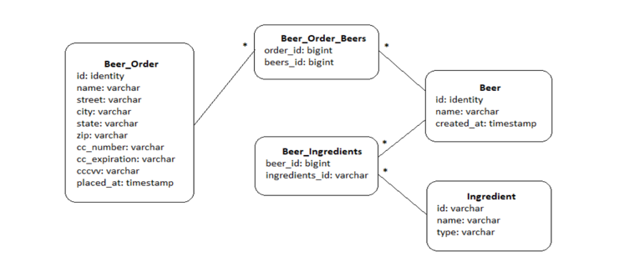
WORKING WITH DATA:
Database model:

Slide 35
Persisting data with Spring Data JPA
-We’re going to add data persistence to the Beer Shop application.
This can be done using Spring support for JDBC (Java Database Connectivity) but also with JPA (Java Persistence API) in order to eliminate even more code.
-One of the most interesting and useful features provided by Spring Data is the ability to automatically create repositories, based on a repository specification interface.

Slide 36
Spring DATA JPA:
-Add the dependency
-Add annotations to model classes:
@Entity
@Id
@GeneratedValue
@Table
Annotations for specifying relationships between the tables
-Chose the db (h2 in our case)
-Add database properties to application.properties file

Slide 37
H2 database
-embedded db
-datasource defined in application properties:
spring.datasource.url=jdbc:h2:mem:beershopdb
spring.datasource.driverClassName=org.h2.Driver
spring.datasource.username=admin
spring.datasource.password=admin
spring.jpa.database-platform=org.hibernate.dialect.H2Dialect
spring.h2.console.enabled=true
-localhost:8080/h2-console (if we enable it explicitely)

Slide 38
Declaring JPA repositories
CrudRepository,JpaRepository,PagingAndSortingRepository
Create repository interfaces for each entity
There is already implementation for the methods specific to those repos
When the application starts, Spring Data JPA automatically generates an implementation on the fly.

Slide 39
Customizing JPA repositories
-List<Order> findByDeliveryZip(String deliveryZip);
When generating the repository implementation, Spring Data examines any methods in the repository interface, parses the method name, and attempts to understand the method’s purpose in the context of the persisted object (an Order, in this case).
Spring Data knows that this method is intended to find Orders, because you’ve parameterized JpaRepository with Order. The method name, findByDeliveryZip(), makes it clear that this method should find all Order entities by matching their deliveryZip property with the value passed in as a parameter to the method.

Slide 40
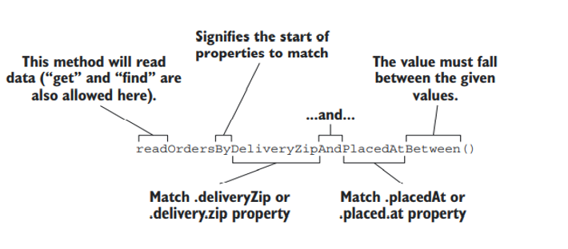
Although the naming convention can be useful for relatively simple queries, method names could get out of hand for more complex queries. In that case, feel free to name the method anything you want and annotate it with @Query to explicitly specify the query to be performed when the method is called, as this example shows:
@Query("Order o where o.deliveryCity='Novi Sad'")
List<Order> readOrdersDeliveredInNoviSad();

Slide 41
UNIT TESTING WITH SPRING BOOT
-A Unit Test Case is a part of code, which ensures that another part of code (method) works as expected. To achieve the desired results quickly, a test framework is required. JUnit is a perfect unit test framework for Java programming language.
-Junit features:
-Provides annotations to identify test methods.
-Provides assertions for testing expected results.
-Provides test runners for running tests.
-JUnit tests allow you to write codes faster, which increases quality.
-Easy to use and analyze results->JUnit shows test progress in a bar that is green if the test is running smoothly, and it turns red when a test fails.

Slide 42
MOCKITO
-Mockito is a mocking framework for unit tests written in Java. It is an open source framework available at github. You can use Mockito with JUnit to create and use mock objects during unit testing.
-@Mock annotation
-@MockBean annotation
-@Spy

Slide 43
Testing the controller
Spring comes with some powerful test support that makes testing a web application easy.
@WebMvcTest - special test annotation provided by Spring Boot that arranges for the test to run in
the context of a Spring MVC app.
The test class is injected with a MockMvc object for the test to drive the mockup.

Slide 44
USEFUL LINKS AND SOURCES
https://spring.io/
https://docs.spring.io/spring-boot/docs/current/reference/htmlsingle/
https://martinfowler.com/articles/injection.html
https://medium.com/quick-code/spring-vs-spring-boot-a-comparison-of-these-java-frameworks-14a1b594657
https://www.javatpoint.com/spring-vs-spring-boot-vs-spring-mvc
https://spring.io/guides/gs/spring-boot/
http://maven.apache.org/index.html
Spring in Action, 5th edition

